Slide 1
Change your approach to faculty collaboration
Melanie Sorrell, DVM, MS, MSLS
Science Librarian
Peggy Hoon, RN, JD
Scholarly Communications Librarian
J. Murrey Atkins Library, UNC Charlotte

Slide 2
Seek opportunities
Co-authorship of literature reviews
Open Access publishing and copyright

Slide 3
Play a more integral role within academic writing and publishing teams outside of the library
Image posted here for presentation depicted colleagues working together.
Found at
:(http://www.evolllution.com/distance_online_learning/happily-after-moocs-industry-unite-professional-development/)
Notes:
.

Slide 4
Librarian vs Research Assistant
Image posted here for presentation depicted worker carrying heavy load of files.
Found at: (http://www.egr.msu.edu/mars/members.htm)

Slide 5
Image posted here for presentation depicted lawyer at podium accepting “lawyer of the year” award.
Found at: (http://lib.law.washington.edu/announce/nlw08/jealousy.html)

Slide 6
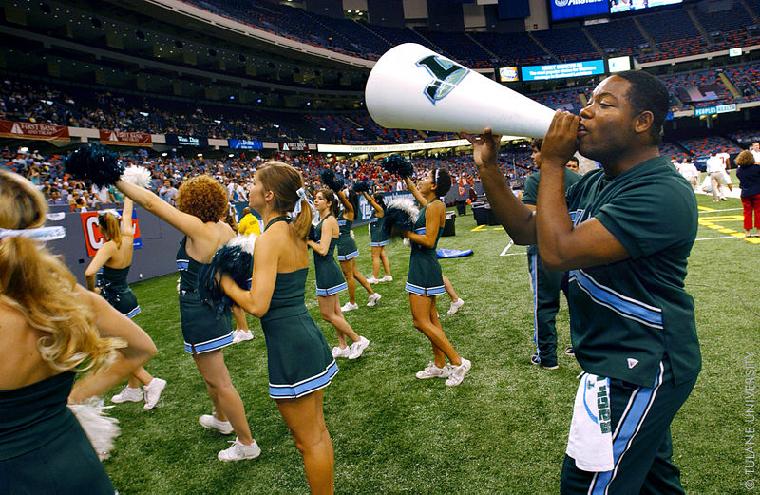
Seeking co-authorship of literature reviews? Publicize your intentions.
Source: Albert Herring
(http://commons.wikimedia.org/wiki/File:Megaphone_(3638663013).jpg)

Slide 7
Negotiation
Can you put yourself in a position to negotiate for co-authorship for a faculty member’s literature review?
Contribute to article content.

Slide 8
What details should be discussed with the article’s lead author ?
Topic
Date range for search strategy?
What journal? OA?
Deadlines
Invited article?
Other co-authors
Offer to write the search strategy for inclusion into the literature review article
Are key citations or articles available?
Author order
This is what I can do for you….

Slide 9
Draft timeline
Week of:
Feb 24: Librarian reads background content and sends list of keyword phrases to Lead Author to focus on the best search strategy for literature review
Feb 24: Librarian creates DropBox folders for project.
March 3: Lead Author responds to Librarian’s list to delete and add to search strategy terms
March 3: Librarian takes Lead Author’s recommendations and begins search. Librarian will submit Interlibrary Loan requests for materials.
March 10: Librarian submits materials to EndNote Web (citations) and DropBox (PDFs) while Lead Author provides feedback to direct search
March 17: Librarian finishes up search and content submission
March 31: Lead Author, Other Co-Author, and other finish combining information
April 28: Lead Author, Other Co-Author, and other finish first draft and submit to Librarian and other Co-Authors for editing
May 5: Librarian and others respond to first draft with edits
May 12: Lead Author and others choose author order, refine draft, and submit to Journal

Slide 10
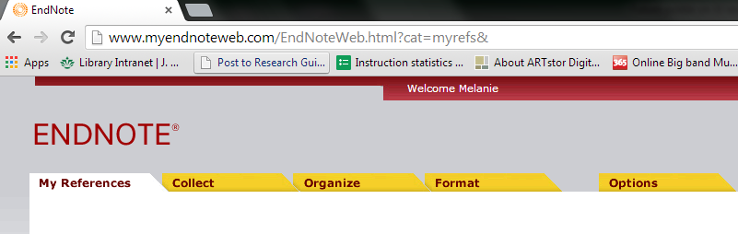
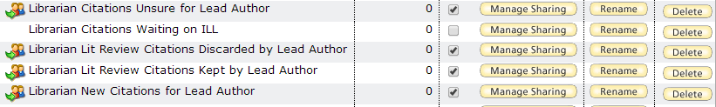

Slide 11
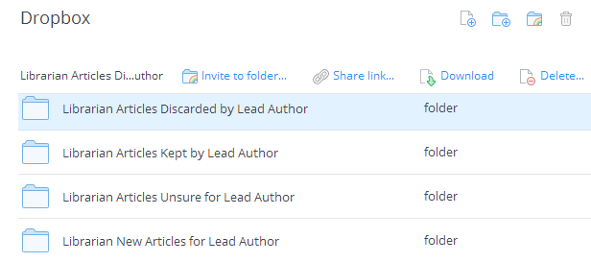

Slide 12
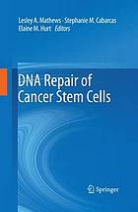
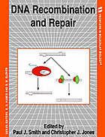
Increase familiarity with the topic

Slide 13
Medline Medical Subject Headings | Include?
"DNA damage" | Y
"DMC1 protein, human" | N
"DNA mismatch repair" | Y
"Homologous recombination" | Y
"DNA-(Apurinic or Apyrimidinic Site) Lyase" | Y
Keyword or search phrase possibilities for other databases
SSB | Y
"DNA damage detection" | Y
"Proliferating cell nuclear antigen p145" | N
"DNA damage checkpoint response " | Y
ATRIP | Y

Slide 14
Search strategy description
A search of the English literature using free text words was conducted during November 2013 in four databases: BIOSIS Citation Index® (Thomson Reuters Scientific, Inc. (Thomson®), Philadelphia, PA, USA), MEDLINE® (National Library of Medicine, Bethesda, MD, USA), and Web of Science® (Thomson Reuters Scientific, Inc. (Thomson®), Philadelphia, PA, USA) on the Web of Knowledge℠ (Thomson Reuters Scientific, Inc. (Thomson®), Philadelphia, PA, USA) platform and ScienceDirect® (Elsevier B.V., Amsterdam, North Holland, Netherlands). Search terms were selected to retrieve articles on oxidative stress-induced DNA damage and the accompanying response and repair mechanism. Articles were excluded if the content primarily involved ultraviolet radiation mutagenicity. Reference lists from these retrieved articles were screened for additional sources.
The search strategy for Web of Knowledge℠ was as follows:
Topic=(“Oxidative DNA damage” OR “oxidative stress-induced DNA damage” OR “oxidative damage” OR “oxidative stress “) AND Topic=(“DNA damage response” OR “DDR” OR “DNA damage response mechanism” OR “DNA damage checkpoint response” OR “DNA damage checkpoint” OR “base excision repair” OR “nucleotide excision repair” OR “mismatch repair” OR “oxidative DNA damage detection” OR “oxidative stress-induced DNA damage detection”) AND Topic=(“APE1” OR “APE2” OR “apurinic/apyrimidinic endonuclease 1” OR “apurinic/apyrimidinic endonuclease 2” OR “ATRIP” OR “ATR interacting protein” OR “ataxia telangiectasia mutated” OR “Chk1” OR “Chk2” OR “checkpoint” OR “ATR-Chk1” OR “ATR-Chk2” OR “single-stranded DNA binding protein” OR “SSB” OR “double strand break” OR “DSB” OR “homologous recombination” OR “PCNA” OR “proliferating cell nuclear antigen”) Refined by: Languages=( ENGLISH ) AND Document Types=( ARTICLE OR REVIEW ) AND Research Areas=( BIOCHEMISTRY MOLECULAR BIOLOGY OR CELL BIOLOGY OR ONCOLOGY OR BIOTECHNOLOGY APPLIED MICROBIOLOGY OR MICROBIOLOGY )Timespan=1950-2013.

Slide 15
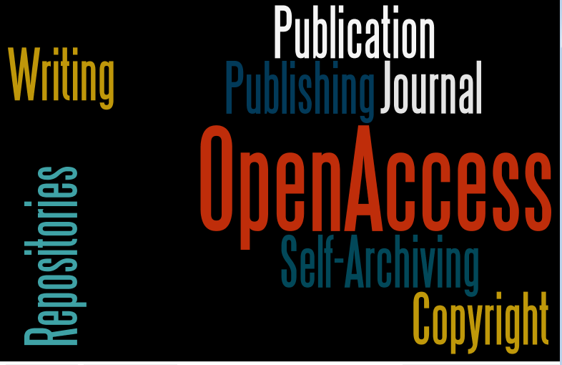

Slide 16
Image posted here for presentation depicted a sample publisher copyright agreement.
Found at:
(http://authorservices.wiley.com/bauthor/lic_samples/eCTA_sample.pdf)

Slide 17
Images
Jensen M. "Happily Ever After? MOOCs and Industry Unite for Professional Development.” Accessed May 19, 2014. (http://www.evolllution.com/distance_online_learning/happily-after-moocs-industry-unite-professional-development)
"DRS: Integrated Hybrid Software Framework for Autonomous Mobile Robot." Michigan State University. (2002) Accessed May 19, 2014. (http://www.egr.msu.edu/mars/members.htm)
"National Library Week, April 13-19, 2008: Stu's Views." University of Washington School of Law. (2008) Accessed May 19, 2014. (http://lib.law.washington.edu/announce/nlw08/jealousy.html)
Wikimedia Commons. "Megaphone (3638663013).jpg" (2002) Accessed May 19, 2014. (http://commons.wikimedia.org/wiki/File:Megaphone_(3638663013.jpg)
Wiley-Blackwell. “Author Services – Copyright Transfer Agreement.” (2014) Accessed May 19, 2014. (http://authorservices.wiley.com/bauthor/lic_samples/eCTA_sample.pdf)

Slide 18
Copyright & Publishing Options
Who are the copyright holder(s) of the work?
  Requirements: must have contributed “original copyrightable expression” to the work
Types of copyright holder(s) under the law
  Single Author
  Joint Holders
  Work for Hire
    Employee/Employer
    Independent Contractors

Slide 19
Joint Copyright Holders
Two or more
Contribute copyrightable expression to a work
Intending, at that time, that their combined contributions be a whole
Each holds an undivided interest in the work as a whole
Only duty to each other is to account for any profits made
Consider an MOU to clarify future matters

Slide 20
Where you publish matters
A subscription journal or an open access journal are the primary choices
Subscription journal will impose both price and use barriers affecting access and downstream use
Open Access journals (here defined) –online, free to world without any use restrictions
Author Resources: https://library.uncc.edu/node/12529

Slide 21
Effect of Your Choice
Subscription Journal
  © Transfer
    Check journal policy for posting in OA IR
    Check SHERPA/ROMEO site
    Need permission
Open Access Journal
  The authors/joint © holders retain the copyright
  They can deposit the work in an OA repository, wherever that is hosted.

Slide 22
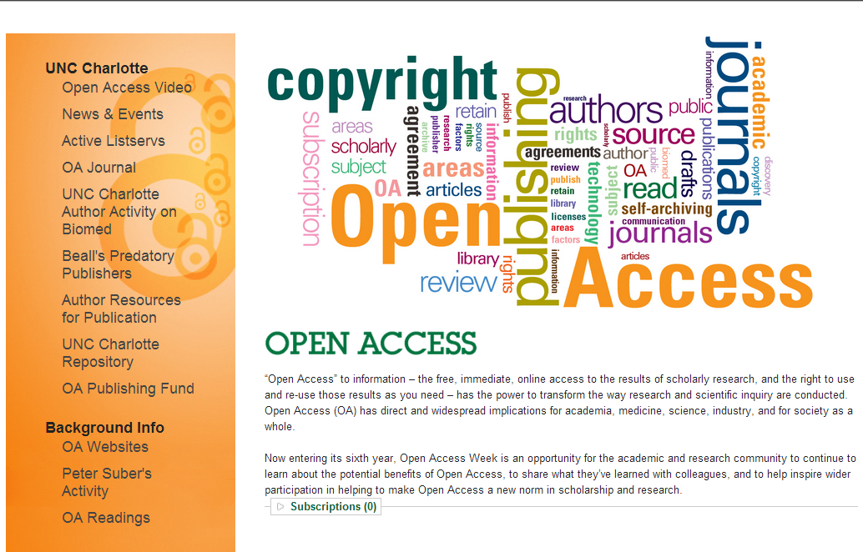
http://library.uncc.edu/openaccess

